Slide 1
RAILWAY RESERVATION SYSTEM

Slide 2
INTRODUCTION
Our project “Train Ticket Reservation system” is a web application which is user friendly and more efficient. In this web application, users can provide the start and the destination locations, train, class, time, ticket quantity and the date of booking. Users can pay using credit/debit cards or by mobile phone. If the user is a government employee, they can have special discounts in this web application.

Slide 3
Tools used:
React Js - front end (client side)
Node Js and Express Js – Backend (server side)
MongoDB - Database

Slide 4
motivation
A website should basically contain user friendly navigation with good usability . Our main focus is to build a website which a naive user can easily interact with, which is not taken care of in the existing system.
The drawbacks and the reviews found on the internet were the motivations for this project.

Slide 5
DRAWBACKS OF EXISTING SYSTEM
Non user friendly
Over crowded user interface
Too many advertisements
Confusing Booking system

Slide 6
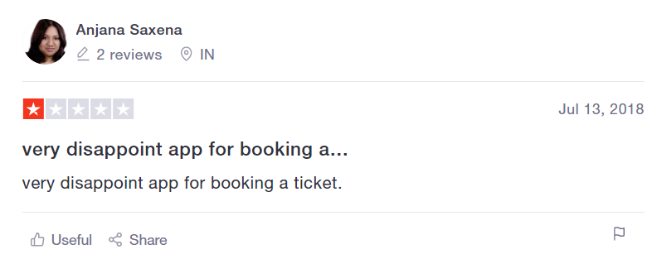
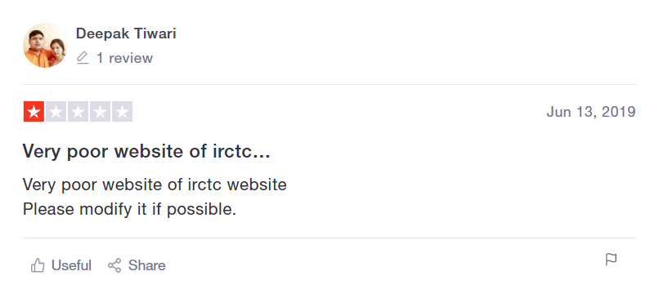
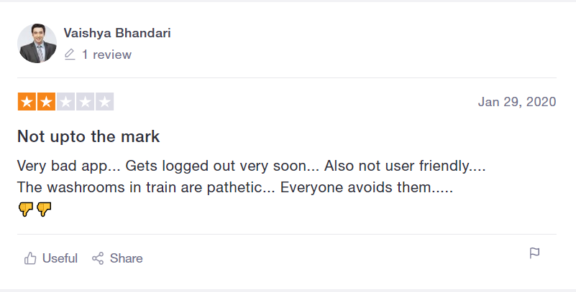
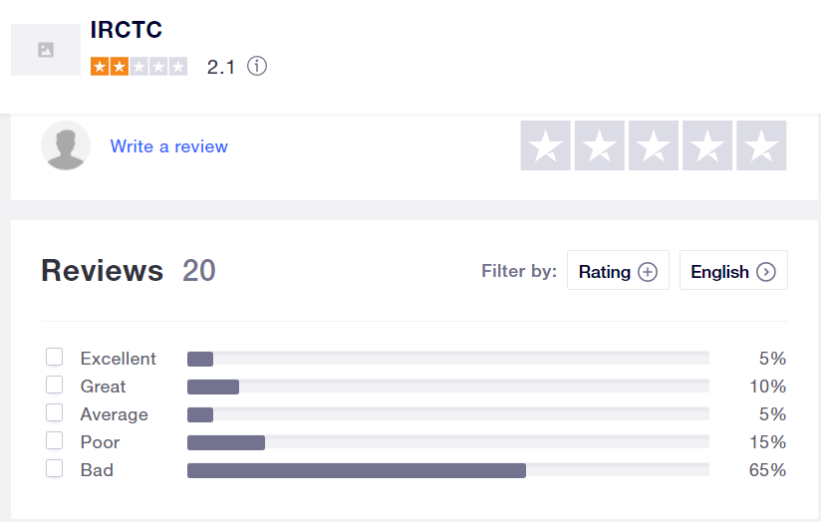
Some reviews on the existing system as found on the internet

Slide 7
modules
Register
Login
Railway
Users
Payment

Slide 8
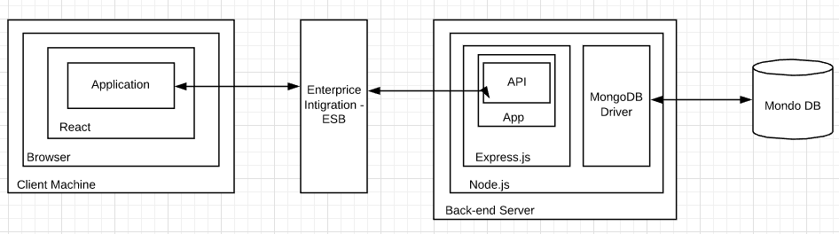
Overall architecture

Slide 9
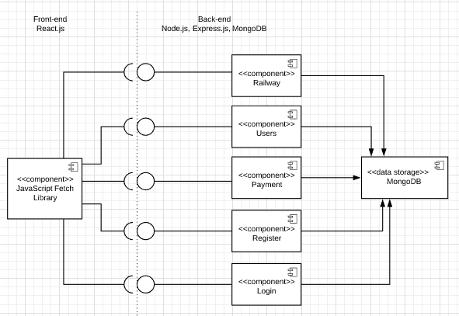
COMPONENT DIAGRAM

Slide 10
IMPLEMENTATIONS

Slide 11
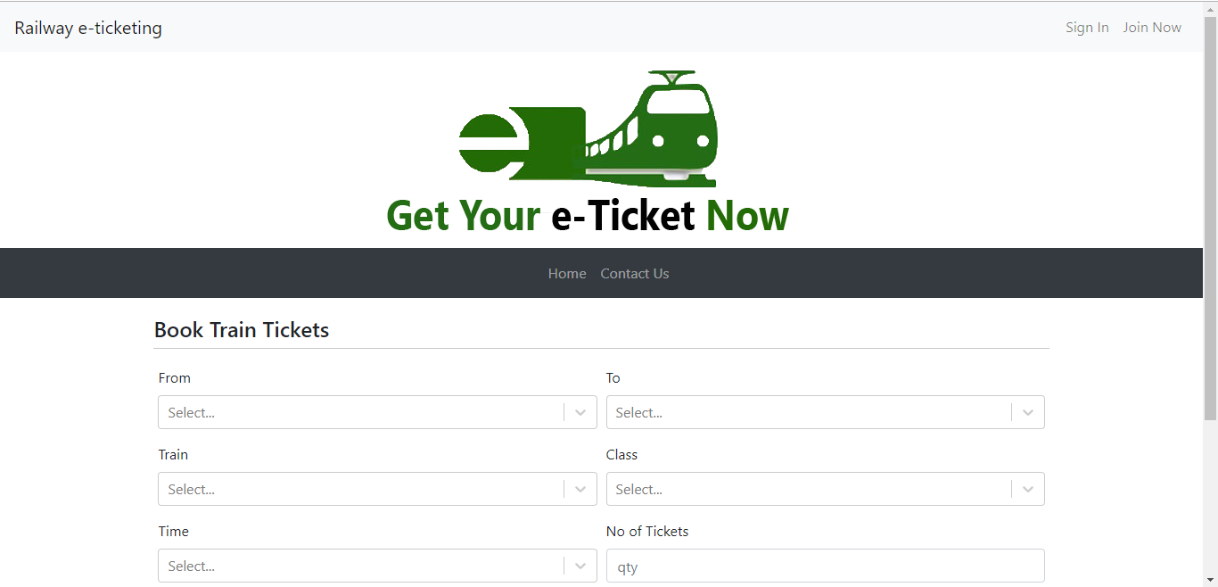
LANDING PAGE

Slide 12
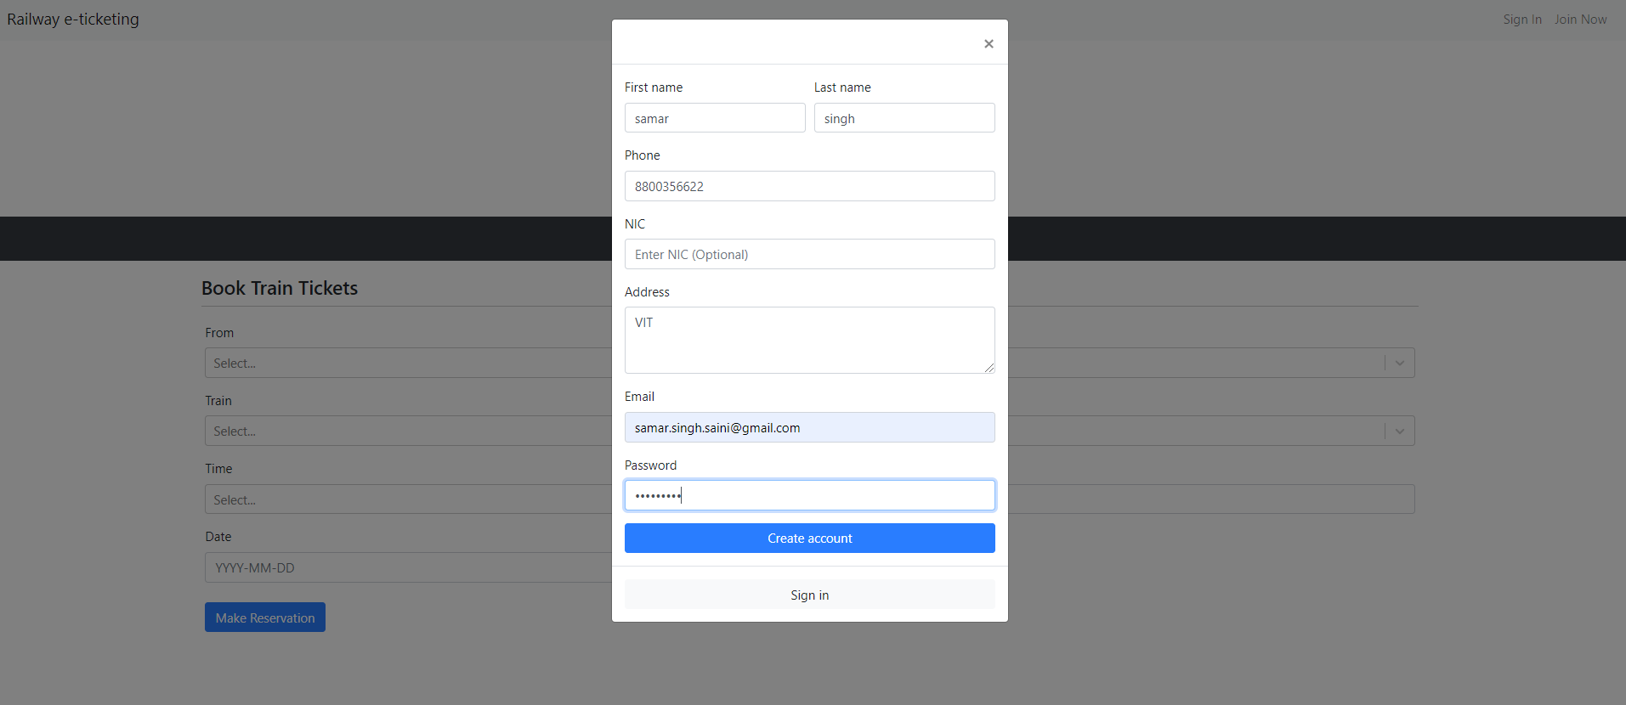
REGISTRATION

Slide 13
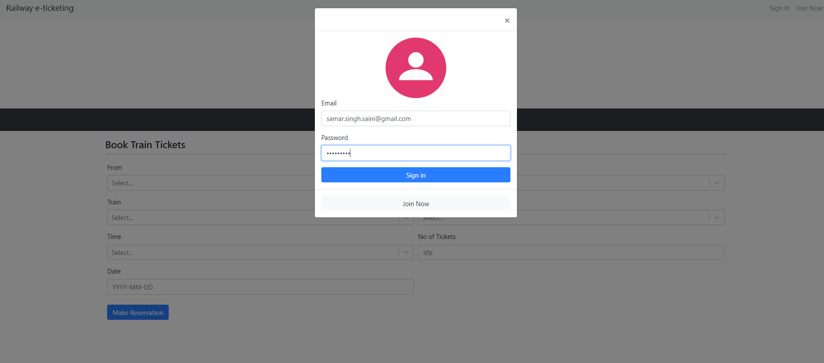
LOGIN

Slide 14
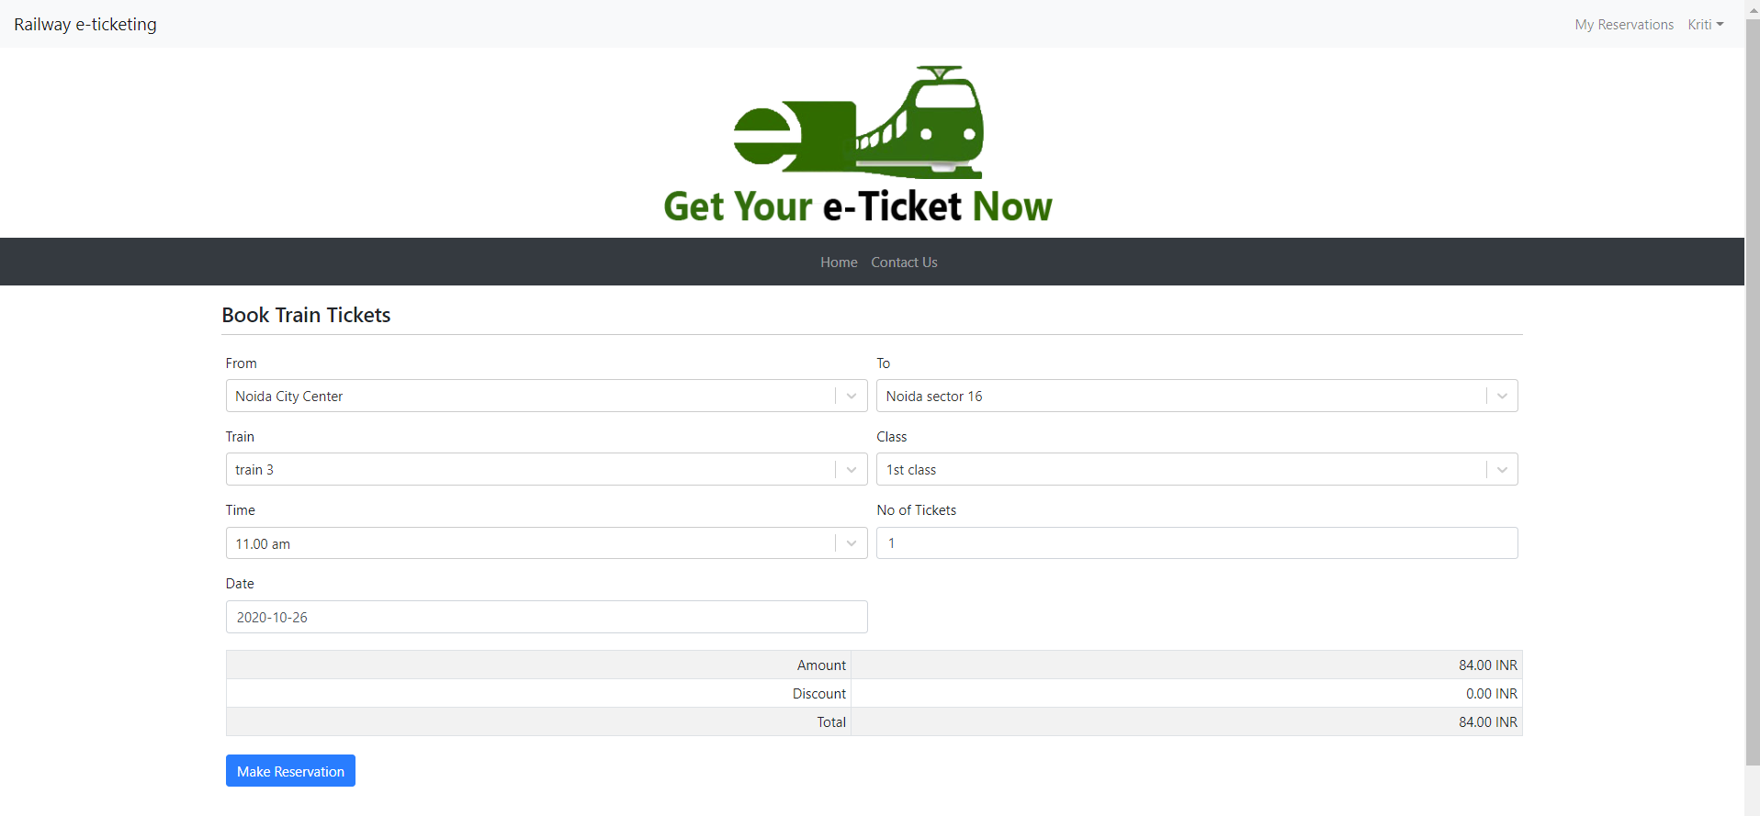
HOME PAGE

Slide 15
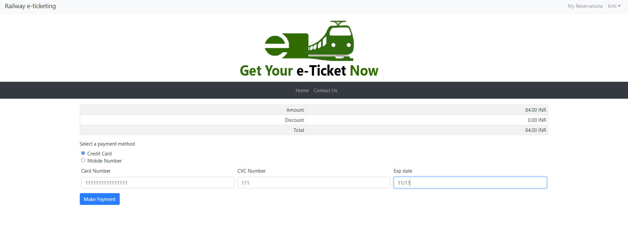
PAYMENT

Slide 16
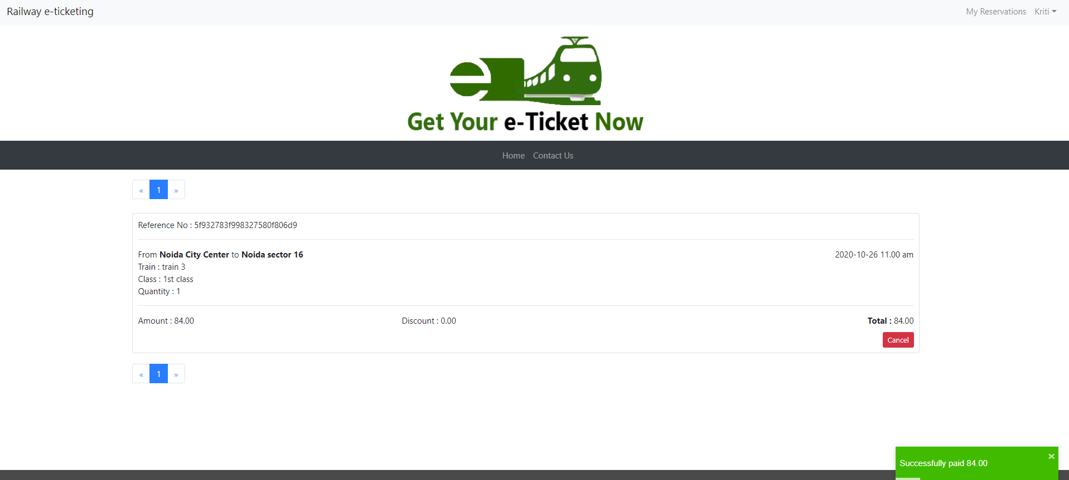
MY RESERVATIONS

Slide 17
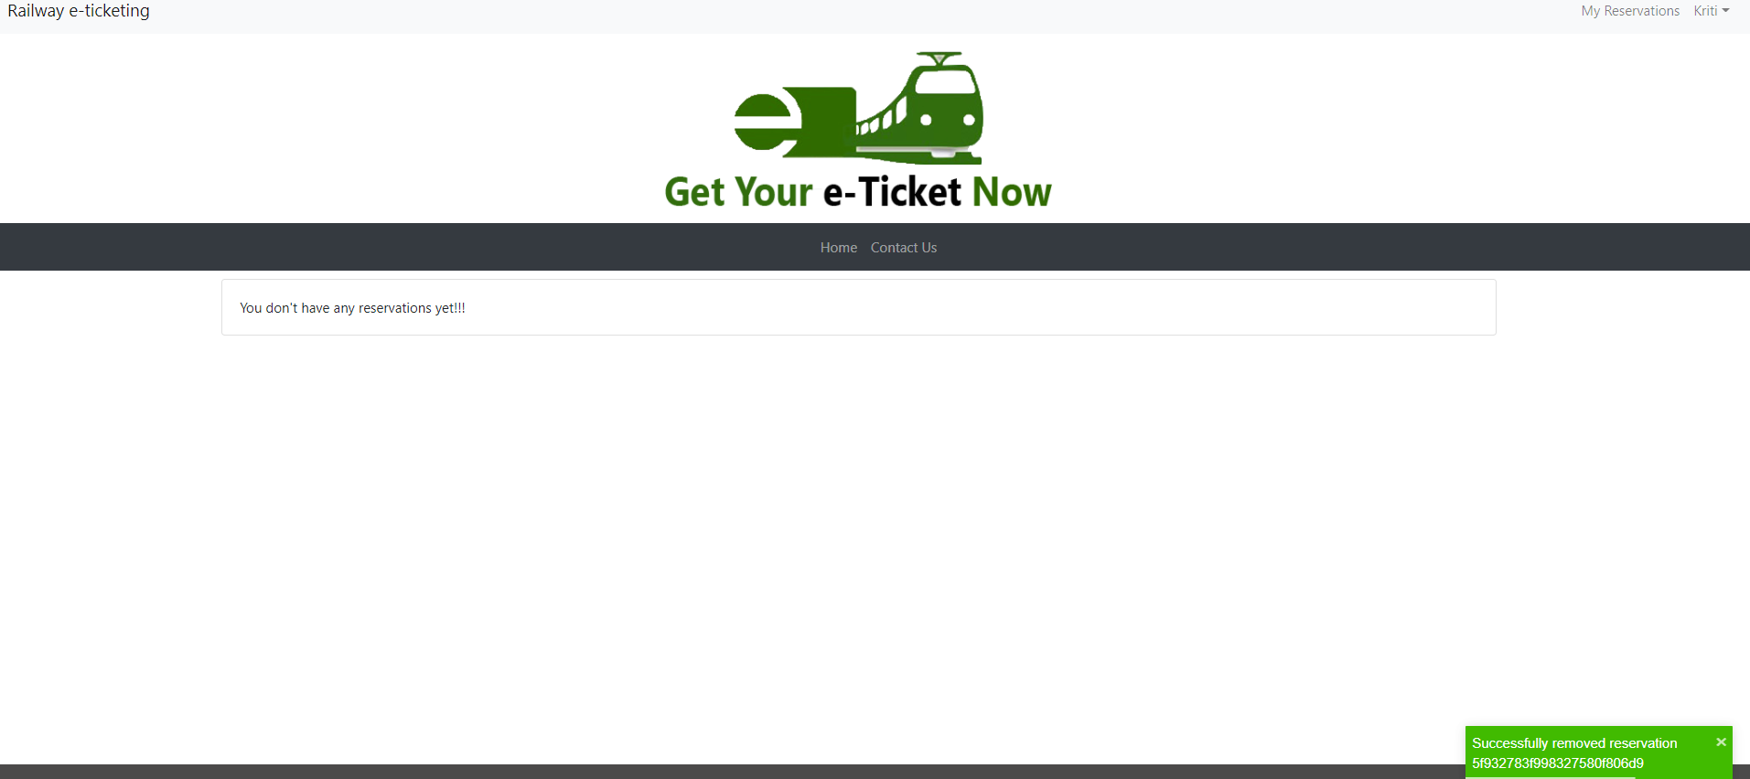
CANCEL RESERVATION

Slide 18
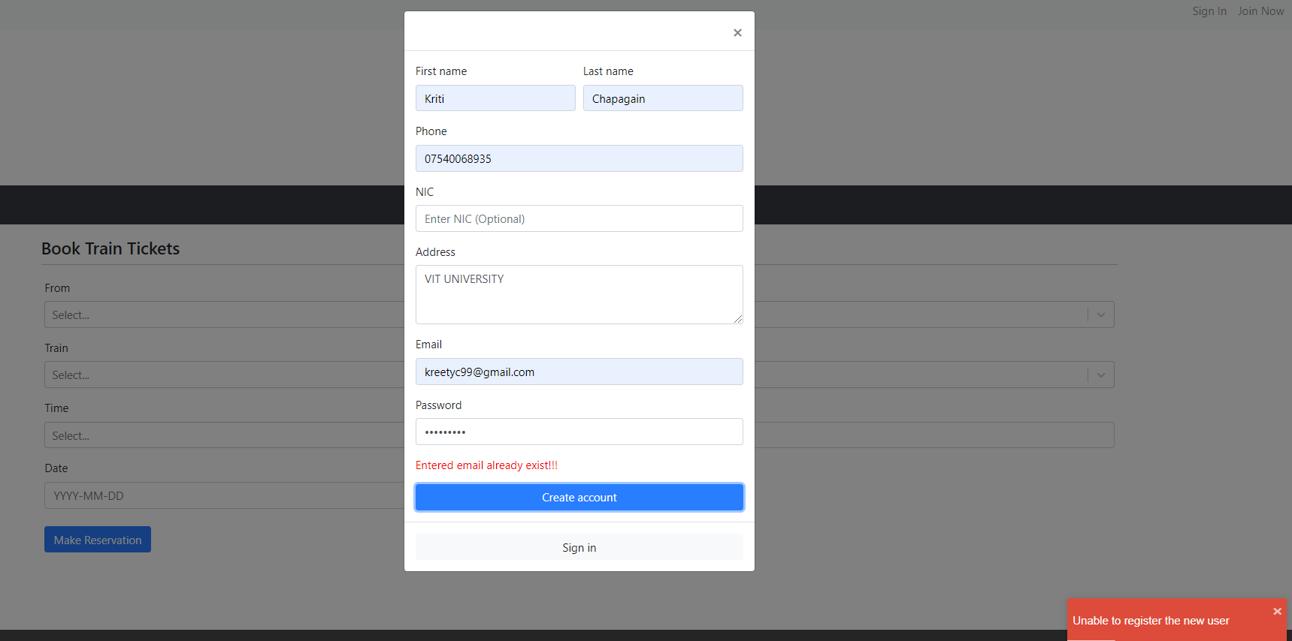
NO MULTIPLE ACCOUNTS WITH SAME EMAIL

Slide 19
TESTING
MANUAL TESTING
OVERALL TESTING

